Slide 1
Sorting
Lesson 5
© 2006 Pearson Addison-Wesley. All rights reserved
10 A-<number>

Slide 2
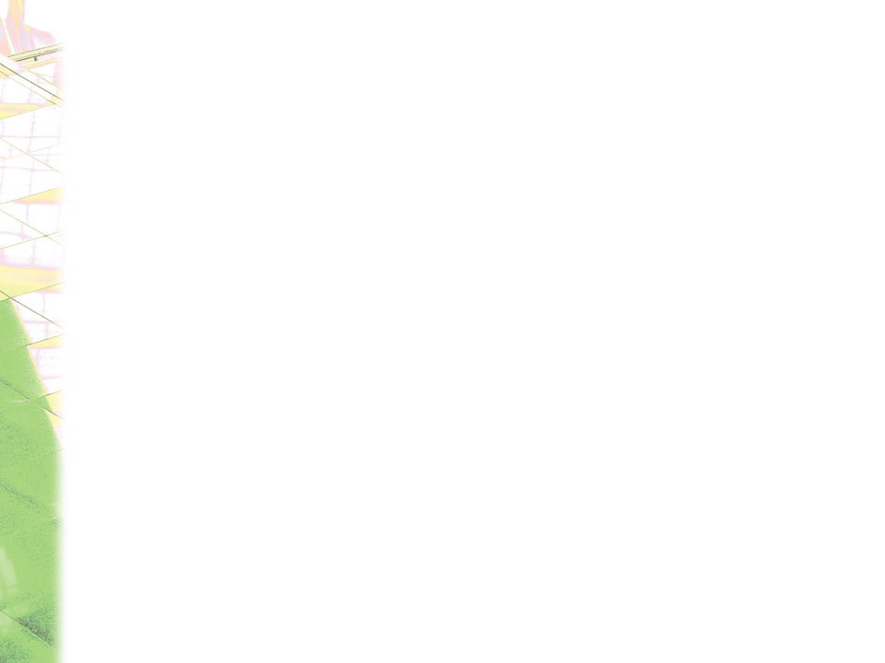
Sorting Algorithms and Their Efficiency
Sorting
  A process that organizes a collection of data into either ascending or descending order
Categories of sorting algorithms
  An internal sort
    Requires that the collection of data fit entirely in the computer’s main memory
  An external sort
    The collection of data will not fit in the computer’s main memory all at once but must reside in secondary storage
© 2006 Pearson Addison-Wesley. All rights reserved
10 A-<number>

Slide 3
Sorting Algorithms and Their Efficiency
Data items to be sorted can be
  Integers
  Character strings
  Objects
Sort key
  The part of a record that determines the sorted order of the entire record within a collection of records
© 2006 Pearson Addison-Wesley. All rights reserved
10 A-<number>

Slide 4
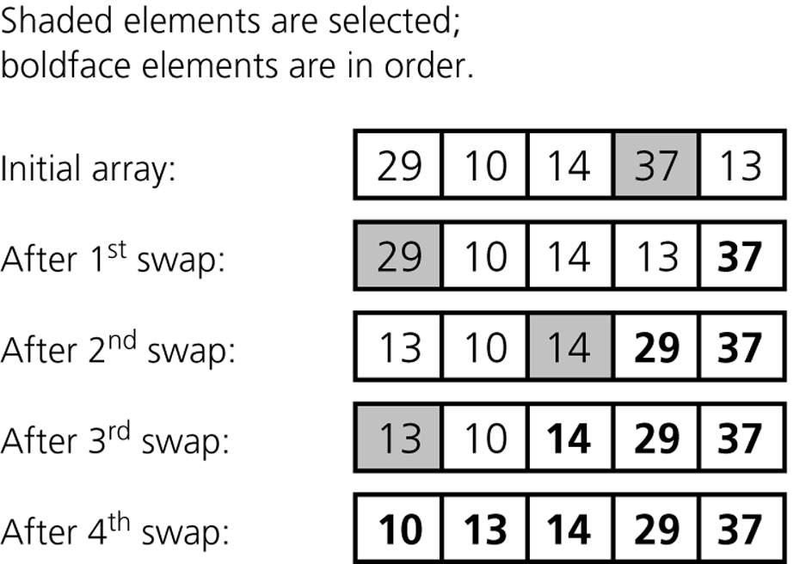
Selection Sort
Selection sort
  Strategy
    Select the largest item and put it in its correct place
    Select the next largest item and put it in its correct place, etc.
Figure 10-4
A selection sort of an array of five integers
© 2006 Pearson Addison-Wesley. All rights reserved
10 A-<number>

Slide 5
Selection Sort Logic
for(i=0; i<size; i++){
for(j=i+1; j<size; j++){
if(list[i] > list[j])
{
temp=list[i];
list[i]=list[j];
list[j]=temp;
}
}
}
© 2006 Pearson Addison-Wesley. All rights reserved
10 A-<number>

Slide 6
Selection Sort
Analysis
  Selection sort is O(n²)
Advantage of selection sort
  The running time does not depend on the initial arrangement of the data (worst case running time is same as best case running time on all data sets)
Disadvantage of selection sort
  It is only appropriate for small n
© 2006 Pearson Addison-Wesley. All rights reserved
10 A-<number>

Slide 7
Bubble Sort
Bubble sort
  Strategy
    Compare adjacent elements and exchange them if they are out of order
      Comparing the first two elements, the second and third elements, and so on, will move the largest elements to the end of the array
      Repeating this process will eventually sort the array into ascending order
© 2006 Pearson Addison-Wesley. All rights reserved
10 A-<number>

Slide 8
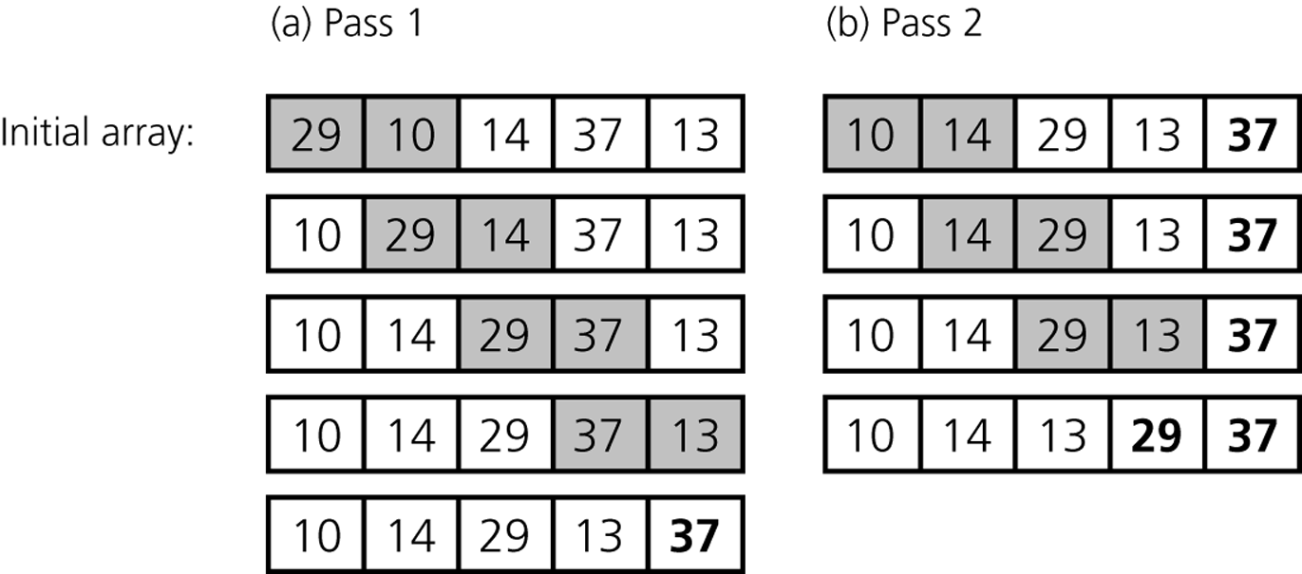
Bubble Sort
Figure 10-5
The first two passes of a bubble sort of an array of five integers: a) pass 1;
b) pass 2
© 2006 Pearson Addison-Wesley. All rights reserved
10 A-<number>

Slide 9
Bubble Sort Logic
void bubbleSort(int array[]) {
int size = array.length;
for (int i = 0; i < size - 1; i++)
for (int j = 0; j < size - i - 1; j++)
if (array[j] > array[j + 1]) {
int temp = array[j];
array[j] = array[j + 1];
array[j + 1] = temp;
}
}
© 2006 Pearson Addison-Wesley. All rights reserved
10 A-<number>

Slide 10
Bubble Sort
Analysis
  Worst case: O(n²)
  Best case: O(n)
© 2006 Pearson Addison-Wesley. All rights reserved
10 A-<number>

Slide 11
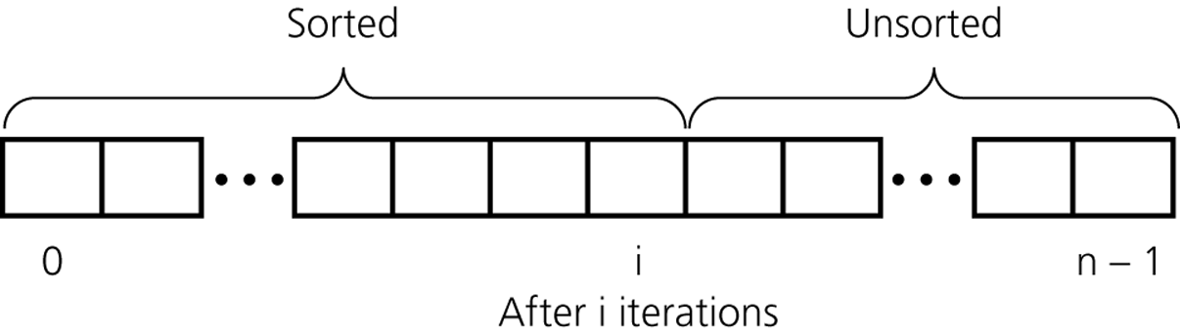
Insertion Sort
Insertion sort
  Strategy
    Partition the array into two regions: sorted and unsorted
    Take each item from the unsorted region and insert it into its correct order in the sorted region
Figure 10-6
An insertion sort partitions the array into two regions
© 2006 Pearson Addison-Wesley. All rights reserved
10 A-<number>

Slide 12
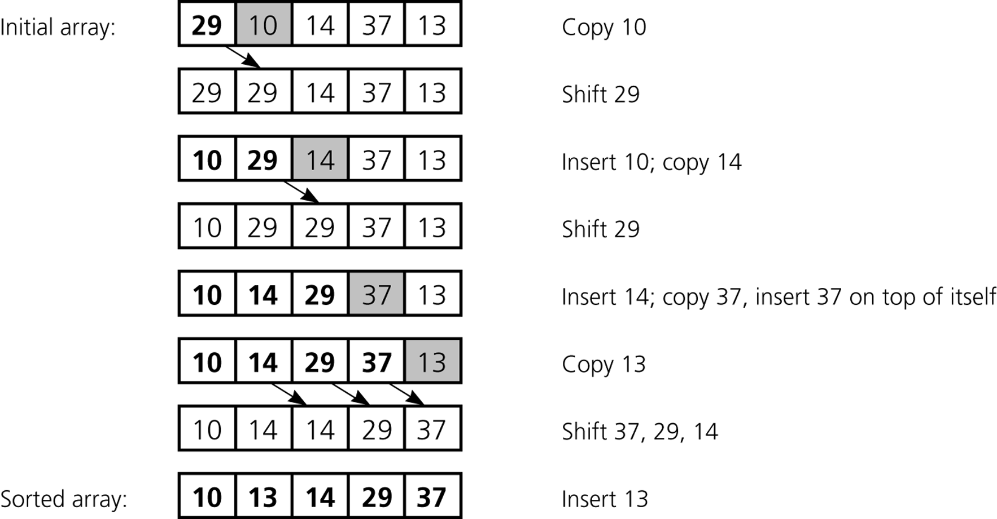
Insertion Sort
Figure 10-7
An insertion sort of an array of five integers.
© 2006 Pearson Addison-Wesley. All rights reserved
10 A-<number>

Slide 13
Insertion Sort Logic
INSERTION-SORT(A)
for i = 1 to n
key ← A [i]
j ← i – 1
while j > = 0 and A[j] > key
A[j+1] ← A[j]
j ← j – 1
End while
A[j+1] ← key
End for
© 2006 Pearson Addison-Wesley. All rights reserved
10 A-<number>

Slide 14
Insertion Sort
Analysis
  Worst case: O(n²)
  For small arrays
    Insertion sort is appropriate due to its simplicity
  For large arrays
    Insertion sort is prohibitively inefficient
© 2006 Pearson Addison-Wesley. All rights reserved
10 A-<number>

Slide 15
Mergesort
Important divide-and-conquer sorting algorithms
  Mergesort
  Quicksort
Mergesort
  A recursive sorting algorithm
  Gives the same performance, regardless of the initial order of the array items
  Strategy
    Divide an array into halves
    Sort each half
    Merge the sorted halves into one sorted array
© 2006 Pearson Addison-Wesley. All rights reserved
10 A-<number>

Slide 16
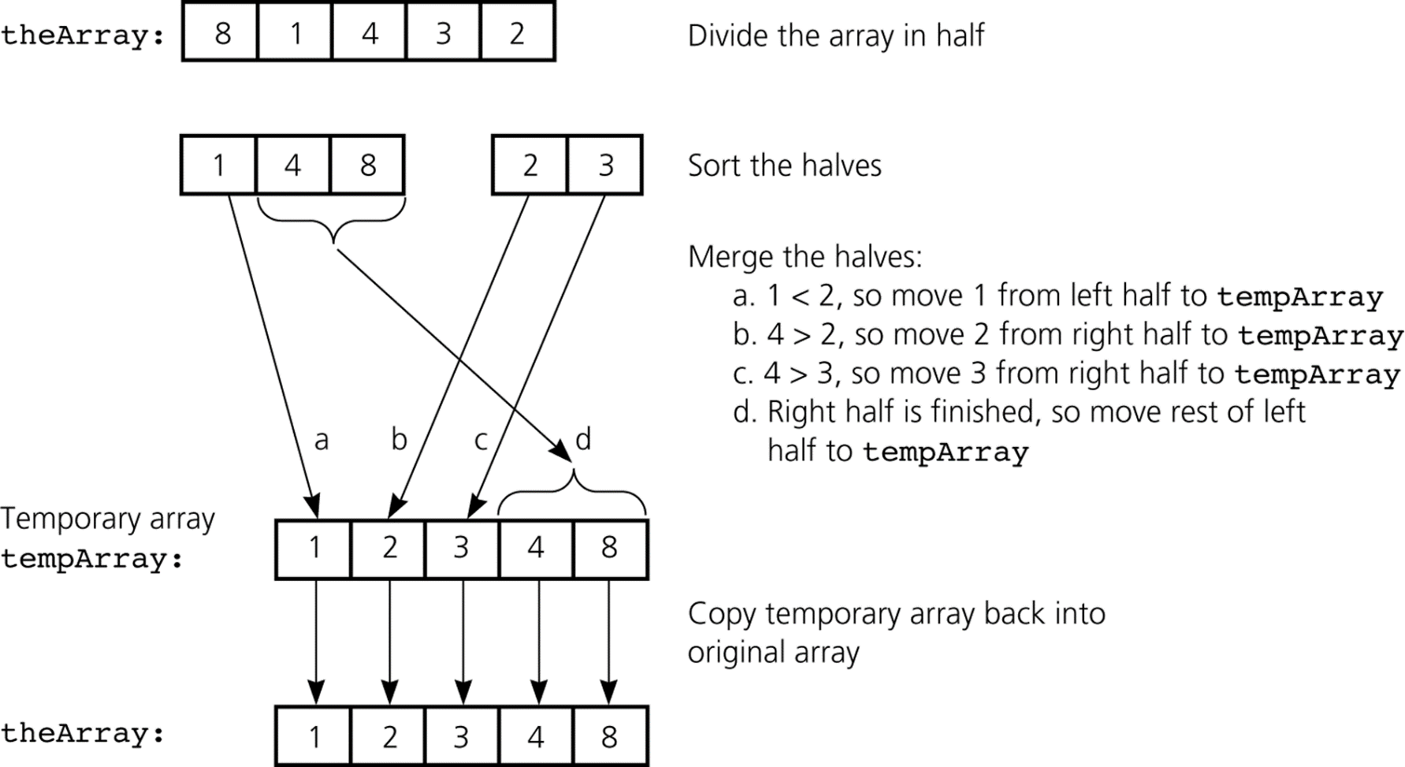
Mergesort
Figure 10-8
A mergesort with an auxiliary temporary array
© 2006 Pearson Addison-Wesley. All rights reserved
10 A-<number>

Slide 17
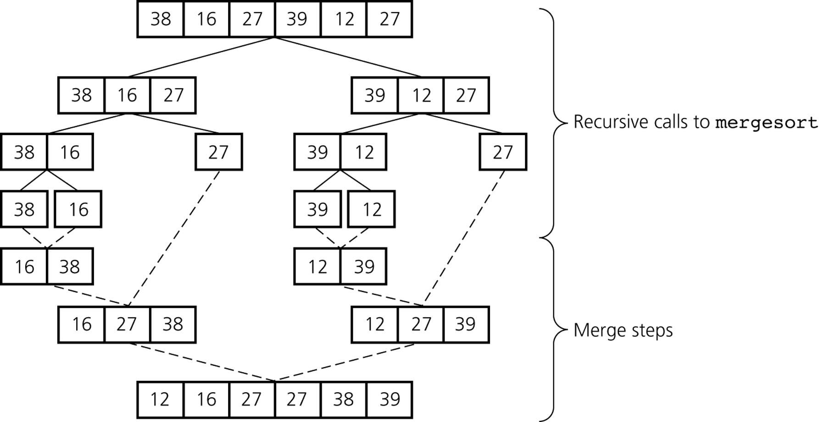
Mergesort
Figure 10-9
A mergesort of an array of six integers
© 2006 Pearson Addison-Wesley. All rights reserved
10 A-<number>

Slide 18
Mergesort
Analysis
  Worst case: O(n log₂n)
  Average case: O(n log₂n)
  Advantage
    It is an extremely efficient algorithm with respect to time
  Drawback
    It requires a second array as large as the original array
© 2006 Pearson Addison-Wesley. All rights reserved
10 A-<number>

Slide 19
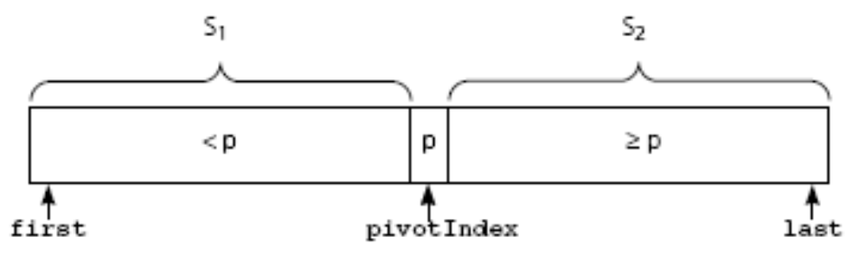
Quicksort
Quicksort
  A divide-and-conquer algorithm
  Strategy
    Partition an array into items that are less than the pivot and those that are greater than or equal to the pivot
    Sort the left section
    Sort the right section
Figure 10-12
A partition about a pivot
© 2006 Pearson Addison-Wesley. All rights reserved
10 A-<number>

Slide 20
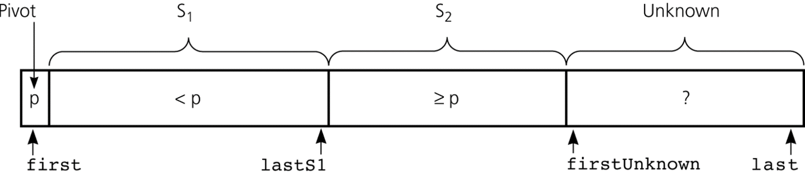
Quicksort
Using an invariant to develop a partition algorithm
  Invariant for the partition algorithm
    The items in region S₁ are all less than the pivot, and those in S₂ are all greater than or equal to the pivot
Figure 10-14
Invariant for the partition algorithm
© 2006 Pearson Addison-Wesley. All rights reserved
10 A-<number>

Slide 21
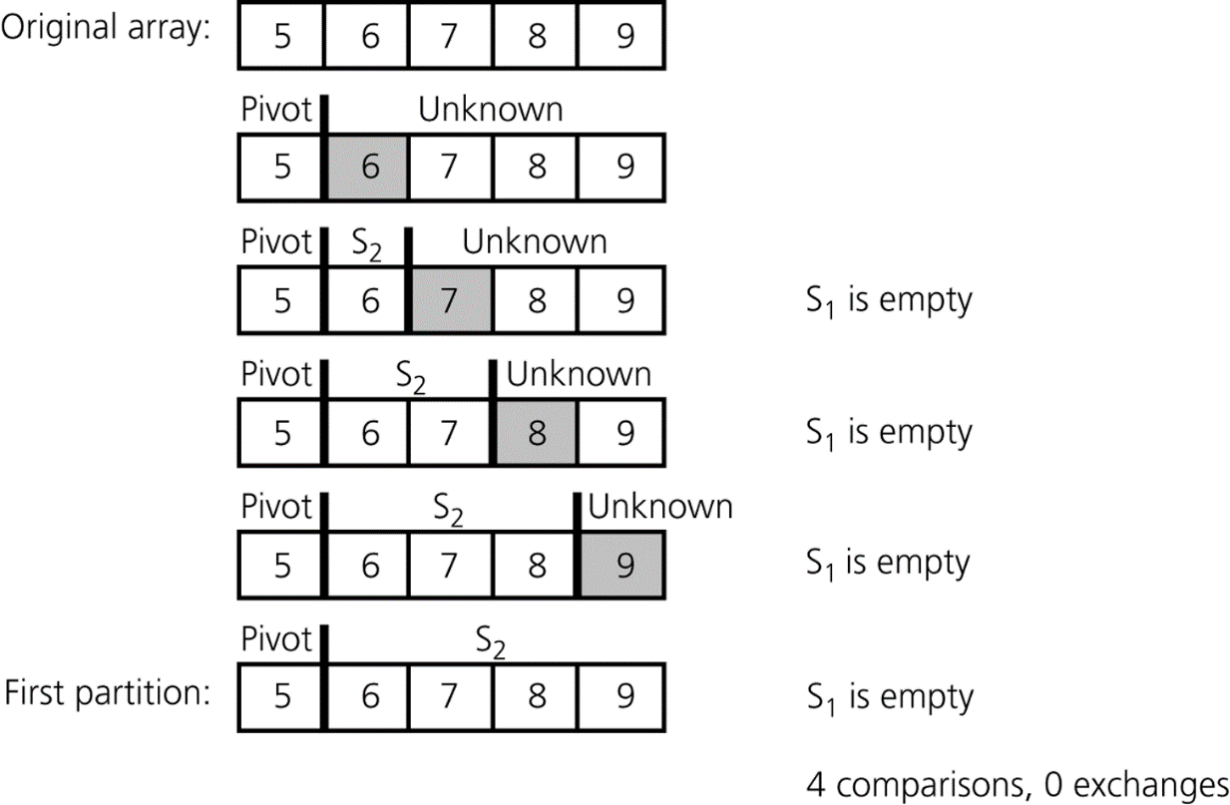
Quicksort
Analysis
  Worst case
    quicksort is O(n²) when the array is already sorted and the smallest item is chosen as the pivot
Figure 10-19
A worst-case partitioning with quicksort
© 2006 Pearson Addison-Wesley. All rights reserved
10 A-<number>

Slide 22
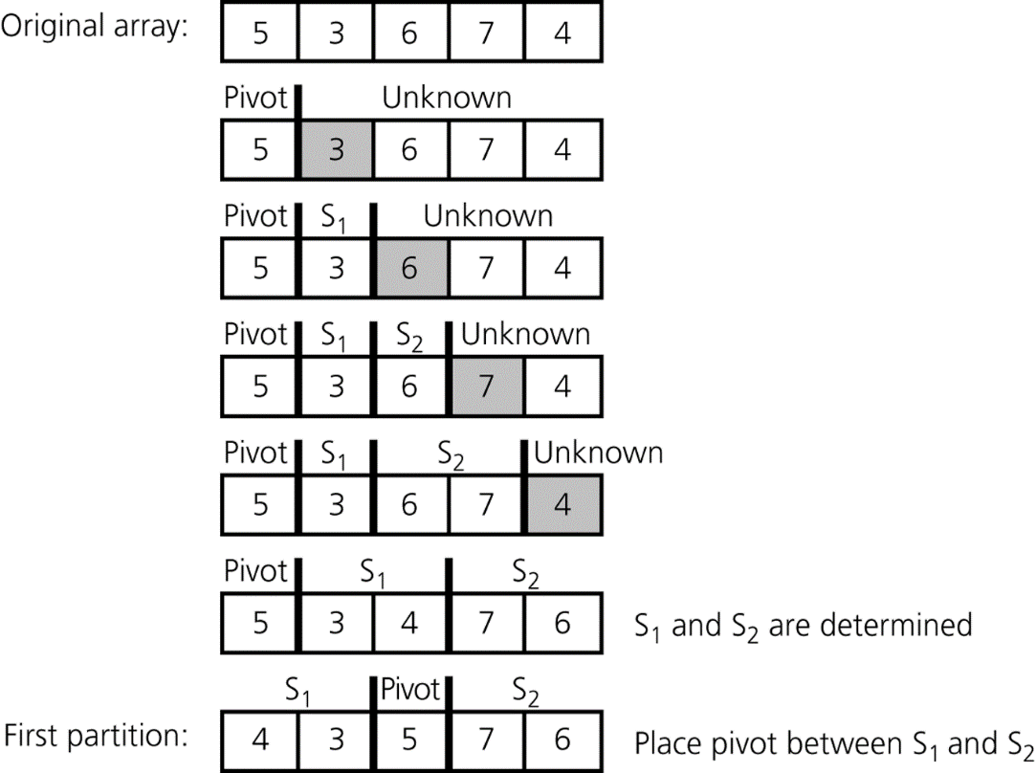
Quicksort
Analysis
  Average case
    quicksort is O(n * log₂n) when S₁ and S₂ contain the same – or nearly the same – number of items arranged at random
Figure 10-20
A average-case partitioning with quicksort
© 2006 Pearson Addison-Wesley. All rights reserved
10 A-<number>

Slide 23
Quicksort
Analysis
  quicksort is usually extremely fast in practice
  Even if the worst case occurs, quicksort’s performance is acceptable for moderately large arrays
© 2006 Pearson Addison-Wesley. All rights reserved
10 A-<number>

Slide 24
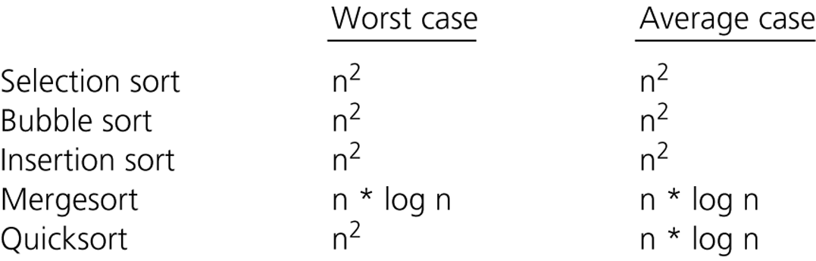
A Comparison of Sorting Algorithms
© 2006 Pearson Addison-Wesley. All rights reserved
10 A-<number>

Slide 25
Summary
Worst-case and average-case analyses
  Worst-case analysis considers the maximum amount of work an algorithm requires on a problem of a given size
  Average-case analysis considers the expected amount of work an algorithm requires on a problem of a given size
Order-of-magnitude (aka asymptotic) analysis can be used to choose an implementation for an abstract data type
Selection sort, bubble sort, and insertion sort are all O(n²) algorithms
Quicksort and mergesort are two very efficient sorting algorithms (O(nlog₂n))
© 2006 Pearson Addison-Wesley. All rights reserved
10 A-<number>

